Slide 1
Creating & Customizing SharePoint 2010 Sites
Notes:
Microsoft has made big investments into SharePoint 2010 to make it a robust platform that can quickly respond to business needs. In this module, you will get a whirlwind tour of how to get around the SharePoint 2010 environment and gain an understanding of the different components that combine together to make up this platform.

Slide 2
Agenda
Introducing SharePoint 2010 Components
The new SharePoint 2010 UI & Navigation
SharePoint Administration Options
Sites as Collection of Pages
Overview of the Various Site Templates

Slide 3






SharePoint 2010
Intranet
Enterprise Client Access License
Standard Client Access License
Internet / Extranet
Enabling Technologies
Notes:
SharePoint is a business collaboration platform for the Enterprise and the Internet.
There are three primary SKUs for SharePoint 2010:
Microsoft SharePoint Foundation 2010:The base platform on which to build solutions.
SharePoint 2010 Server Standard: A premium product with pre-built components and services.
SharePoint 2010 Server Enterprise: In addition to Standard components, Enterprise licenses contain additional functionality.
SharePoint 2010 only runs on 64-bit operating systems.

Slide 4


Microsoft SharePoint 2010: The Business Collaboration Platform for the Enterprise & Web
Ribbon UI
SharePoint Workspace
SharePoint Mobile
Office Client and Office Web App Integration
Standards Support
Business Connectivity Services
InfoPath Form Services
External Lists
Workflow
SharePoint Designer
Visual Studio
API Enhancements
REST/ATOM/RSS
Tagging, Tag Cloud, Ratings
Social Bookmarking
Blogs and Wikis
My Sites
Activity Feeds
Profiles and Expertise
Org Browser
Sites
Composites
Communities
PerformancePoint Services
Excel Services
Chart Web Part
Visio Services
Web Analytics
SQL Server Integration
PowerPivot
Insights
Content
Enterprise Content Types
Metadata and Navigation
Document Sets
Multi-stage Disposition
Audio and Video Content Types
Remote Blob Storage
List Enhancements
Search
Social Relevance
Phonetic Search
Navigation
FAST Integration
Enhanced Pipeline
Notes:
The value proposition of SharePoint 2010 can be split across 6 workloads (aka functional areas). Here is a quicker decoder ring to understand what each piece of the pie is all about.
Sites: Collaboration (e.g. Team sites)
Communities: Social networking (Blogs, Wikis, User profiles)
Search: Content discovery and connecting people
Content: ECM:WCM, DM & RM
Composites: Building no-code applications with external data (BCS) & Office clients (InfoPath, Workspace)
Insights: Business Intelligence and Reporting

Slide 5
Agenda
Introducing SharePoint 2010 Components
The new SharePoint 2010 UI & Navigation
SharePoint Administration Options
Sites as Collection of Pages
Overview of the Various Site Templates

Slide 6
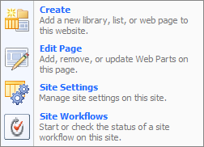
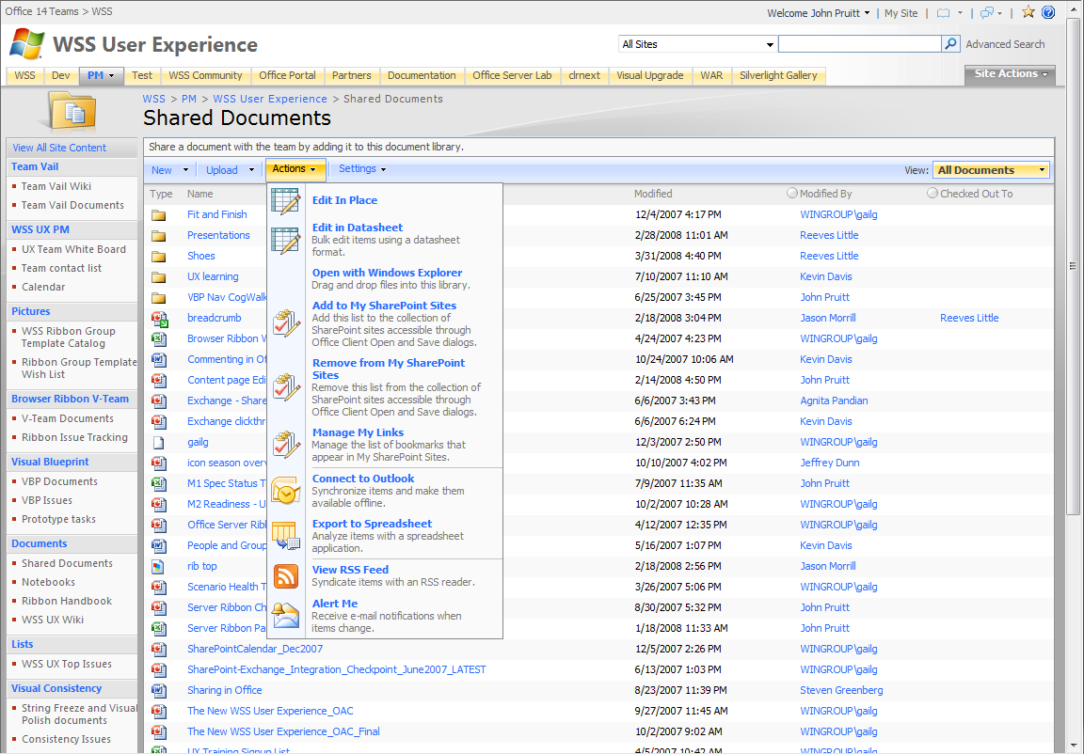
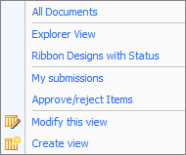
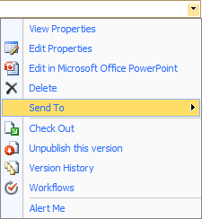

SharePoint 2007 Command Surfaces
Commands EVERYWHERE
Notes:
There were many different surfaces offered in interacting with SharePoint 2007. These surfaces each have unique aspects and ways to interact with the product. For instance, the ECB dropdown, Site Actions, List Actions might all contain items that operate on the list. It is not entirely clear what command is available in each place, and also, if the command is available outside of the direct list view when that list is placed as a Web Part on a page.

Slide 7
SharePoint 2007 Navigation
Page reloads and navigations
Notes:
When users start to use these surfaces things get confusing and aren’t intuitive. Many commands will cause the entire page to reload or cause a navigation to occur. Reloads and navigations are a prime cause for end-users losing focus and getting lost in the product. Information worker productivity is hindered when they have a complex UI to deal with. The product should allow people to focus on what they intend to do, and should prevent people from needing to modify their normal working routines to work around product complexities.

Slide 8
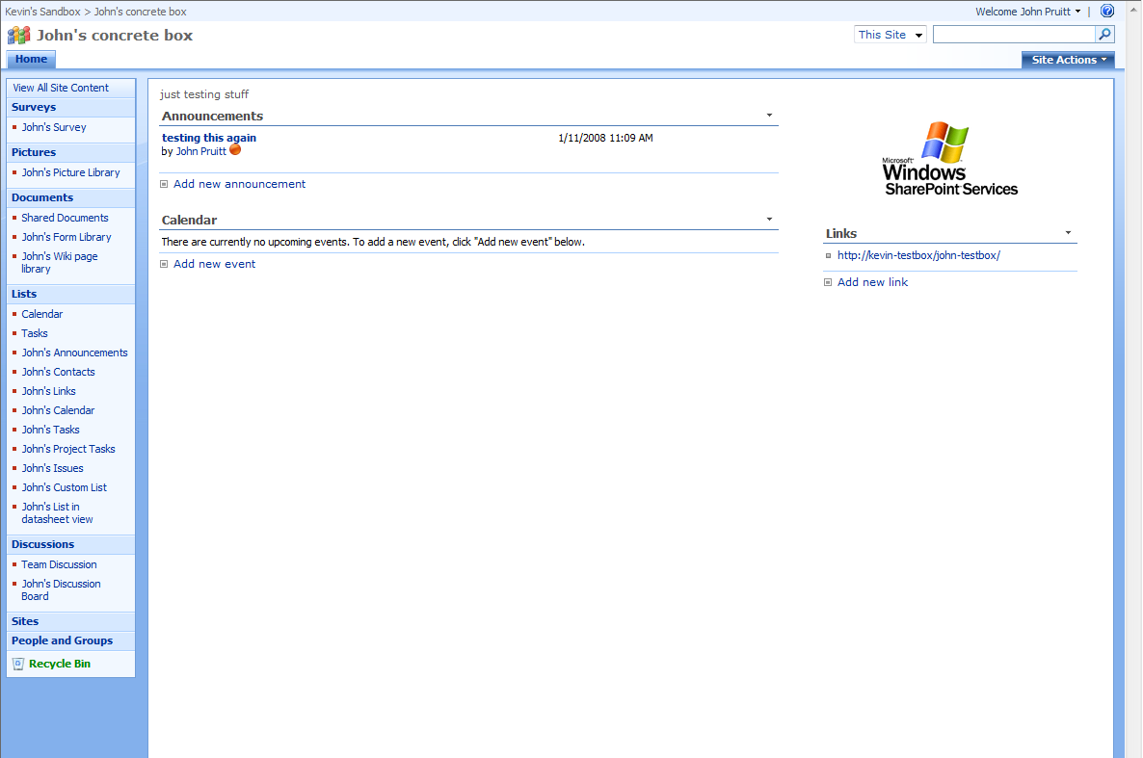
SharePoint 2007 Web Part Interaction
Web part interaction? …a choice of displaying one command or full toolbar which adds visual clutter
Notes:
An important aspect of SharePoint is its capability to create rich interactive dashboard pages using Web Parts. However, for authors of these Web Parts it is hard to show a rich interface for end-users to interact with. The toolbar is rather ugly, and a single command is rather limited. Having more than one List View Web Part on this page adds to the clutter and does not allow the same level of interaction as when viewing each list separately.

Slide 9
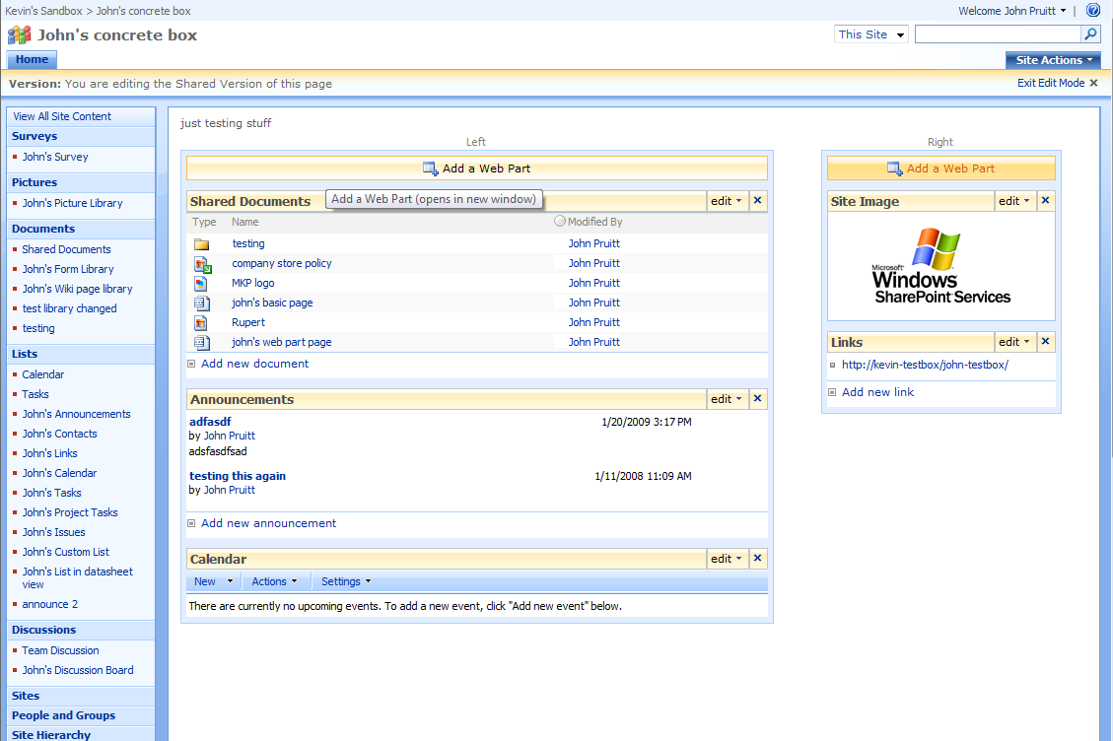
SharePoint 2007 Page Editing
Page Editing – difficult just to add text and your own images
Notes:
Now take a look at the process which people need to go through when wanting to create a basic page containing some formatted text and some data from a list or two.
They need a library to store their page. Shared Documents is used often in a Team site, but this library is named inappropriately.
They need to create a Web Part page and add the appropriate Web Parts.
They need to interact with a Content Editor Web Part, which uses the tool pane to edit content… not intuitive at all!
Adding any rich content like images requires a separate image upload to a picture library and then difficult inclusion on a page (URL based).

Slide 10
Feedback on SharePoint 2007
“SharePoint design is not intuitive and it is difficult to learn and use.”
“Lack of customization is due to difficulty, not lack of desire.”
“End users are not adequately trained on SharePoint. Many obtain little to no training.”
Notes:
Microsoft has listened to customer feedback and has addressed it in the new UI.

Slide 11
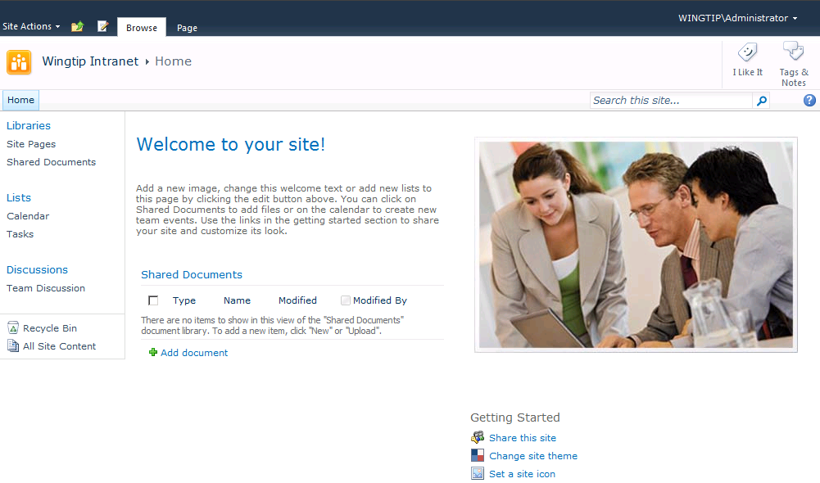
SharePoint 2010 Team Site
Notes:
The SharePoint 2010 Team site:
Home Page is a wiki page (SitePages/Home.aspx).
New lists and galleries created behind the scenes.

Slide 12
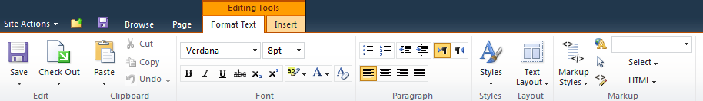
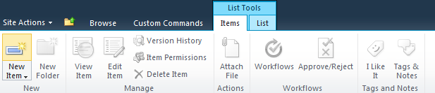

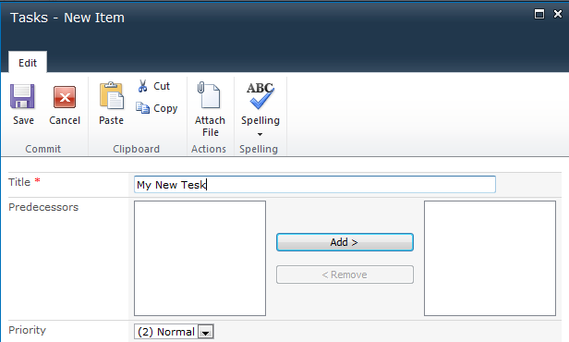

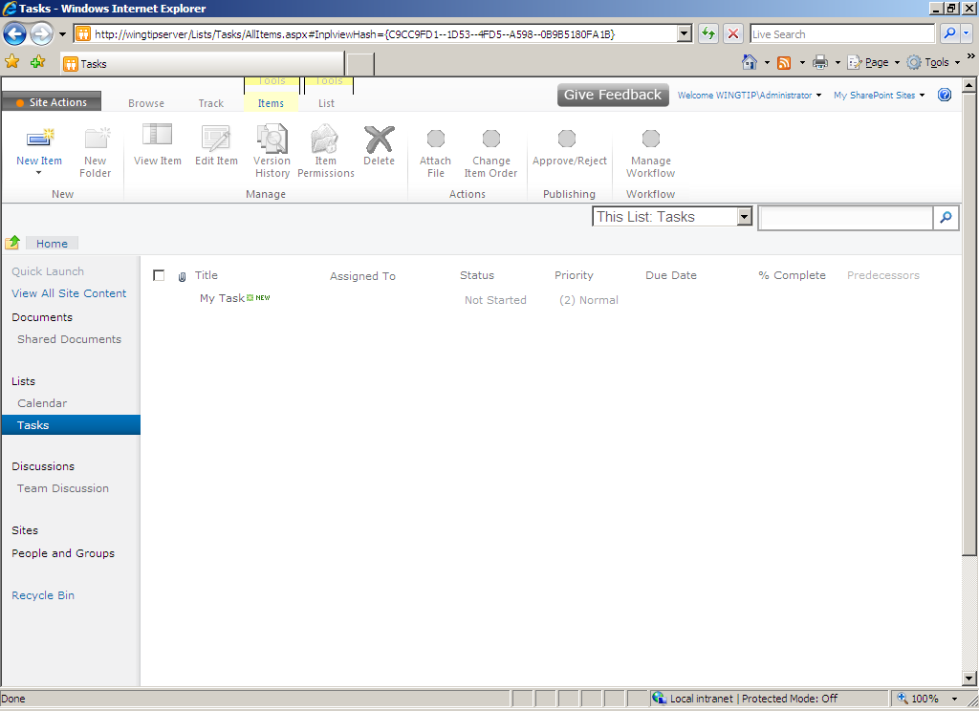
SharePoint User Interface
Server ribbon
In-place editing
Popup dialog
Notes:
SharePoint 2010 has a server-side ribbon to create a consistent experience with the client-side ribbon in Office applications (Office 2007 and above). Using the ribbon, the user can move between modes (e.g. edit mode versus display mode) without noticing much of a delay in the Web browser. In-place editing allows the user to add, edit or delete items in lists and libraries through a popup dialog without having to navigate to a different page. This design delivers an efficient interface and provides more of a Web 2.0 user experience.
The ribbon provides:
Consistency with the client side Office ribbon in style, controls and sense of fluency (automatic resizing for instance).
Streamlined, AJAX enabled, only shows context sensitive content.
Familiar, it will be the place to interact with SharePoint for just about any task that end-users need to get done in the product.

Slide 13
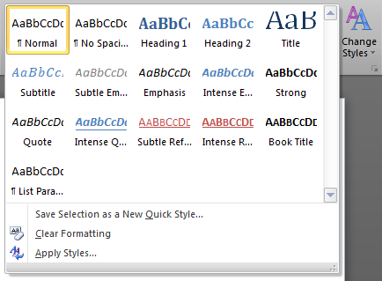
Server Ribbon Controls
What’s In the Ribbon:
Button
Split button menu
Static
Stated
Drop down & Flyout menus
Customizable
Hierarchical
Checkbox
Toggle Button
Label
Textbox
Combo box
Spinner
Table control
Color picker
What’s Not In the Ribbon:
Out
In-ribbon gallery control
Drop down grids are our answer
Notes:
There are a large amount of controls that you can show on the Ribbon, including custom controls. For a large part there is parity between the client and the server ribbon, except for the in-ribbon gallery (the style picker in Word / Excel / PowerPoint). These controls create rich and familiar surfaces for end-users to interact with.

Slide 14
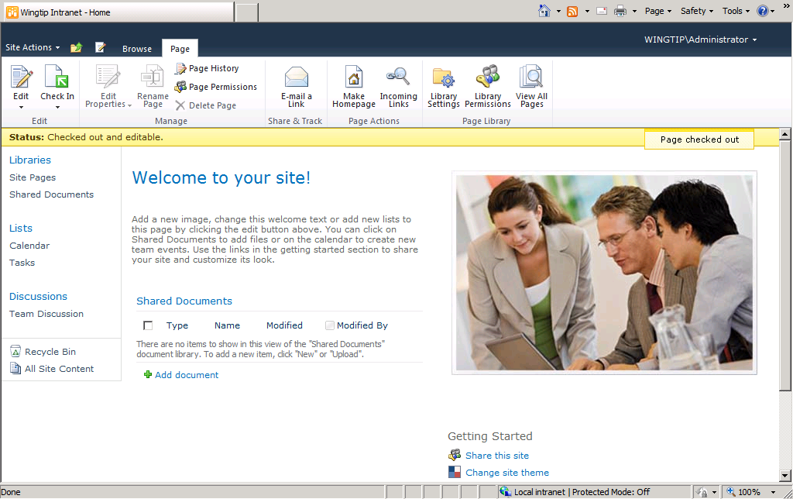
Status Bar and Notification Area
Notification Messages
Status Bar
Notes:
The Status Bar and Notification Area are to prime places to show messages to the end-user. The status bar can be shown in a few fixed colors that indicate a positive or negative status. The Notification area is used for smaller messages. Of course both items can be accessed through code so you can show your own messages using SharePoint infrastructure.

Slide 15
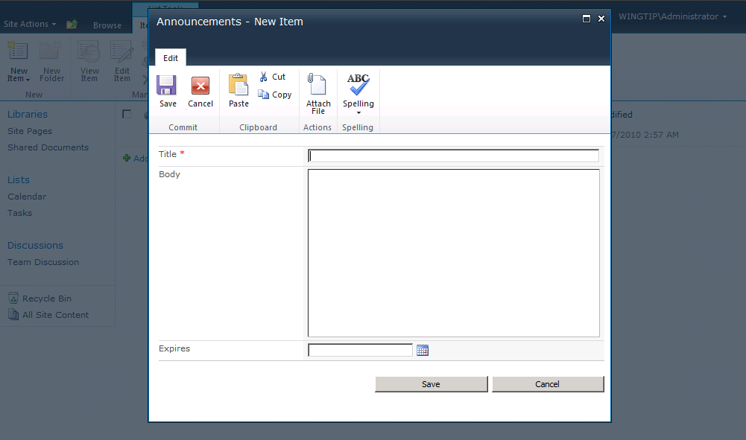
Dialog Framework
Notes:
Next look at a much richer interaction than just showing a message. SharePoint 2010 has a new framework for showing dialogs to the end-user. The dialogs allow people to work with some data without losing focus on the page they were working on to get things done. Closing the dialog will often cause AJAX based refreshes to give a sense of stateful-ness.
The dialog is of course extensible through JavaScript code. You can either show a separate page, or use a DOM element on the source page and show that. You can then determine when the dialog closes and what happens when it has closed.

Slide 16
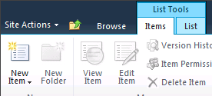
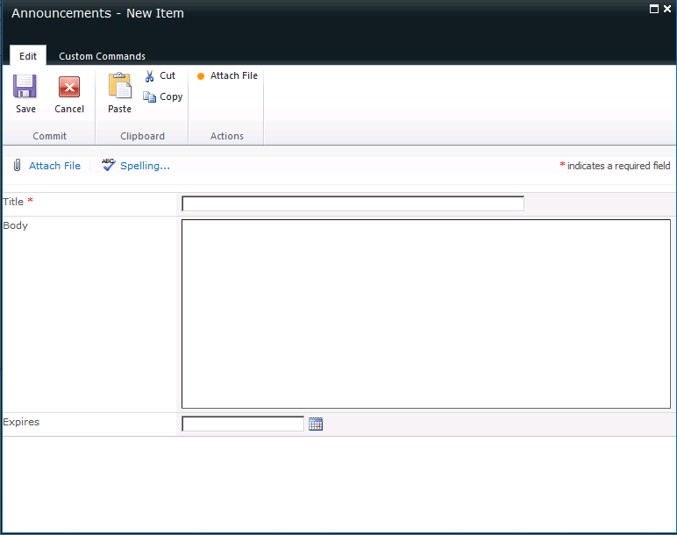
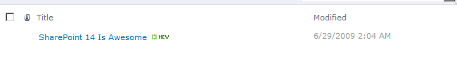
In-Place Editing
Popup dialog
AJAX refresh
Notes:
One of the primary scenarios that a dialog enables is in-place editing. The idea here is that when you add new content to a list, you do not need to navigate to a separate page to perform that task, you can use the ribbon to add a new item, fill in the dialog that appears and the page will refresh automatically. A second important feature is inline-editing. In this mode you can edit list data directly from within the list view, without showing a custom form page in a dialog. This is similar to the DataSheet view in SharePoint 2007 only making use of pure HTML.

Slide 17
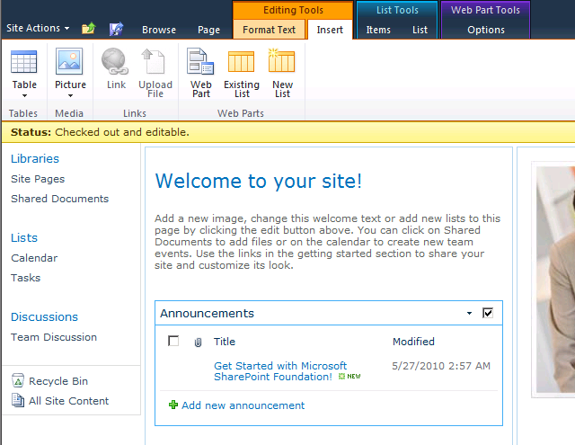
Multi-Level Targetting
No context switching
Contextual tabs – results driven UI (FluentUI)
Notes:
The concept of multi-level targeting is that a ribbon shows content for multiple levels in SharePoint. You are within a site, so the site context applies. You might be on a page, so the page context applies too. On this page you might have selected a list view Web Part, which also add to the context of what the ribbon shows. There is no need to actually go to a list to work with it. You can just do that from anywhere you see the list data.

Slide 18
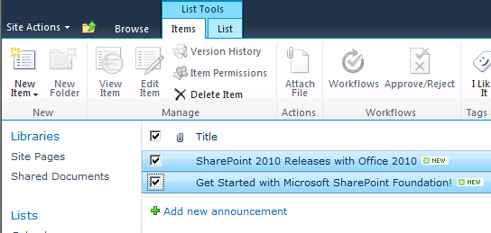
Bulk Operations on List Items
Instead of single-item actions, SharePoint 2010 now supports bulk operations on multiple selections
Notes:
An often asked feature is allowing operations on more than one list item at a time. The new SharePoint 2010 view technology allows not only built-in actions to interact with the selected list items. SharePoint 2010 will also allow custom solutions to reach into a list view Web Part to get its selection and refresh it after changes have occurred.

Slide 19
Standards Compliance
WCAG 2.0 AA
Well-Formed XHTML 1.0
Cross-Browser – Class 1 Browsers
Internet Explorer 7+
Firefox 3.5+
Safari 4.0+
New Rich Text Editor supporting XHTML
Notes:
SharePoint makes use of the XHTML standard for displaying content. Earlier versions of SharePoint either didn’t indicate what to use, or made use of the very much legacy HTML 4.01. This was not an issue for users of Internet Explorer, however, for support in other browsers this wreaked havoc. Even with custom development it is hard to make SharePoint 2007 output the same HTML. This will not be the case for SharePoint 2010 where well-formed XHTML is the standard that is followed.
There are now two tiers of browsers supported, each tier contains a specific set of browsers. Tier 1 consists mainly of 32-bit Internet Explorer 7 and 8 or FireFox 3. Tier 2 contains 64-bit Internet Explorer, Firefox on non-windows OS and Safari.
Note that Internet Explorer 6.0 is no longer a supported browser.

Slide 20
DEMO
SharePoint 2010 User Interface

Slide 21
Agenda
Introducing SharePoint 2010 Components
The new SharePoint 2010 UI & Navigation
SharePoint Administration Options
Sites as Collection of Pages
Overview of the Various Site Templates

Slide 22
SharePoint Hierarchy
Web Application
Top Level Site
Subsite 1
Sub-Subsite 2
Subsite 2
Top Level Site
Subsite 1
Sub-Subsite 2
Subsite 2
Site
Collection
Site
Collection
Notes:
A web application can contain several site collections. A site collection can only have one top level site and any number of subsites.

Slide 23
SharePoint Terminology
- Web Application
- Site Collection
- Site
- List
- Item
- Document Library
- File
- Folder
Notes:
Web Application: An Internet Information Site (IIS)
Site Collection: A collection of sites within a web application.
Site: A container to create, organize and share information.
Document Library: Collection of files to share with site users.
List: Collection of information to share with site users.
Folder: Encapsulate files or list items.
File or Item: An artifact or piece of information stored in a library or list.

Slide 24
Administration Sites
Central Administration
Accessible by farm administrators
Used to manage servers in the farm
Site Settings
Administration site for SharePoint sites
Top level site in the site collection has additional options

Slide 25
Agenda
Introducing SharePoint 2010 Components
The new SharePoint 2010 UI & Navigation
SharePoint Administration Options
Sites as Collection of Pages
Overview of the Various Site Templates

Slide 26
Sites are collections of Pages
Notes:
SharePoint 2010 changes the idea of SharePoint from being sites with collections of lists and Web Parts to the concept of using pages instead of lists as the primary concept modeled by SharePoint. Users think about sites as a collection of pages, and not as a collection of lists. This distinction made it hard for users to customize a SharePoint site to their liking. The default.aspx page on a team site is difficult to edit with lots of navigations and page refreshes.
The goal is to make SharePoint an easier environment for users to customize by makes editing pages very easy.

Slide 27
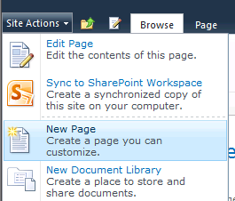
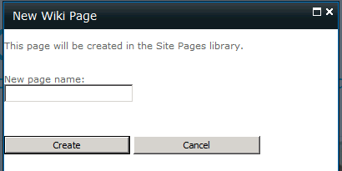
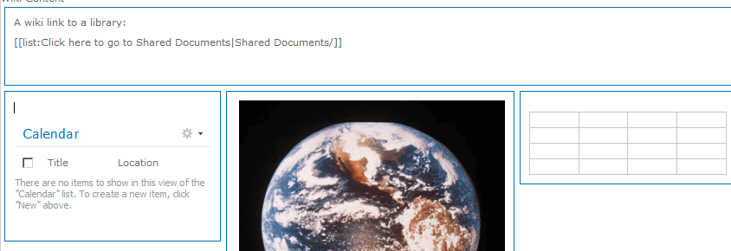
Pages Everywhere
Every team site has a wiki pages library
Create a new page with a single click
Just enter a name
Ready to go
[[Wiki Linking]] to
Pages
Lists
Items
Documents
Notes:
SharePoint takes pages as a primary concept. Basically each new Team site has a Wiki Pages library that stores page content. Wikis have a rich interaction model and allow a site to be easily stitched together using groups of pages and wiki linking. A good demo to show here is to add some new pages to a site and link them together, showing the IntelliSense like experience for end-users.
It is very easy to add new Wiki pages to a site. The New Page button is one of the primary buttons in the Site Actions menu. The dialog only asks the absolute minimum of information it needs to create a page, and then the editing experience is kicking in.

Slide 28
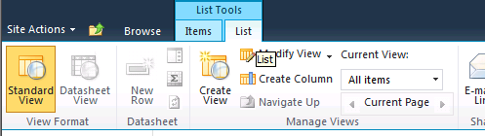
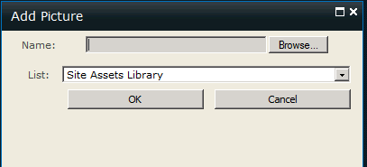

Edit Like in Word
Single click editing experience
Transition to edit is quick and seamless
Type into page and format text like in Word
Full set of rich text controls for formatting and layout
Streamlined insert experience for images, links
Asset library
Edit
Pick Content
Insert
Notes:
In Word adding an image to a document can be done by a single button and a single dialog. In SharePoint 2007 the number of steps are many times larger. SharePoint 2010 brings back the sanity. You can easily insert rich content, not only images, but tables and Web Parts and Lists too.
The Site Asset Library takes away the question of where to store an image that needs to be displayed on a page. Previously users would need to first create a separate library or store the image amongst the pages.

Slide 29
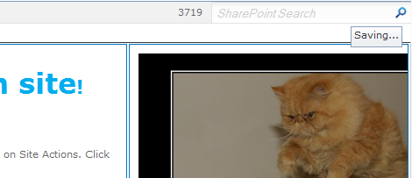
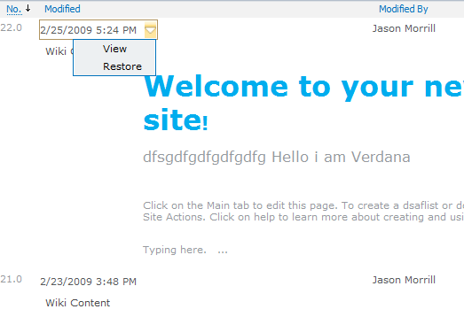
Safe and Simple
Auto-save every minute, no data-loss
Only save if user made changes
Edit \ Stop Editing – no prompts
Whoops Protection
Rich Text Editor has undo stack
Versioning turning on, in case you want to revert
Notes:
Editing content on the Web is a different experience compared to editing in a rich client. Internet connectivity might fail and the server will have a difficult time finding out if you are still there. SharePoint 2010 offers a few capabilities to ensure that you do not lose your edits.

Slide 30
DEMO
Page Creation and Editing

Slide 31
Agenda
Introducing SharePoint 2010 Components
The new SharePoint 2010 UI & Navigation
SharePoint Administration Options
Sites as Collection of Pages
Overview of the Various Site Templates

Slide 32
Site Templates - Collaboration
Template | Purpose
Blank Meeting Workspace | To start from a blank site structure and customize as needed.
Blank Site | To start from a blank site structure and customize as needed.
Decision Meeting Workspace | For meetings that track status or make decisions.
Document Workspace | For colleagues to work together on a document.
Group Work Site | A groupware solution that enables teams to create, organize and share information quickly.
Multipage Meeting Workspace | To plan, organize and capture results of a meeting.
Social Meeting Workspace | To plan social occasions.
Team Site | For teams to organize, author and share information.
Notes:
Collaboration site templates are what teams and departments can use to share and organize their information.

Slide 33
Site Templates – Content and Data
Template | Purpose
Blog | For a person or team to post ideas.
Charitable Contributions Web | A database to track information about fundraising campaigns.
Personalization Site | For delivering personalized views, data and navigation from this site collection into My Site.
Records Center | Enterprise template designed for Records Management.
Visio Process Repository | For teams to quickly view, share and store Visio process diagrams.
Notes:
These site templates are used to gather, store and share information and artifacts in an organization.

Slide 34
Site Templates – Search
Template | Purpose
Basic Search Center | For delivering the search experience.
Enterprise Search Center | For delivering the enterprise level search experience.
FAST Search Center | For delivering the FAST Search experience.
Notes:
Search sites are used to deliver a customized search experience to the users of the application.

Slide 35
Site Templates – Tracking
Template | Purpose
Assets Web Database | To keep track of assets, including asset details and owners.
Charitable Contributions Web | A database to track information about fundraising campaigns.
Contacts Web Database | To manage information about people you work with such as customers and partners.
Issues Web Database | An issues database to manage a set of issues or problems.
Projects Web Database | Project tracking database to track multiple projects.
Notes:
Tracking sites help create databases of information to track information within the organization.

Slide 36
DEMO
Creating Sites and its Components

Slide 37
Summary
Introducing SharePoint 2010 Components
The new SharePoint 2010 UI & Navigation
SharePoint Administration Options
Sites as Collection of Pages
Overview of the Various Site Templates

